Slide 1
Two Stage Operational-Amplifier
Advisor: 陳科宏
Student: 烏孝權、鄭旭恩、陳逸泓
Date:12/18

Slide 2
Outline
Basic design rule
Structure
Stimulation results
Performance table
Problems

Slide 3
Outline
Basic design rule
Structure
Stimulation results
Performance table
Problems

Slide 4

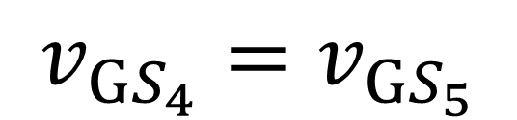
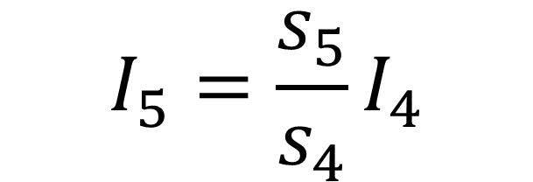
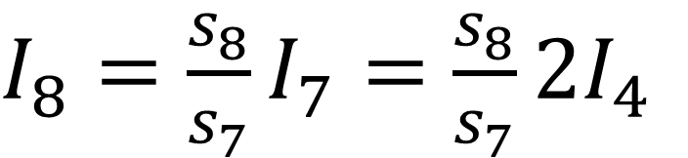
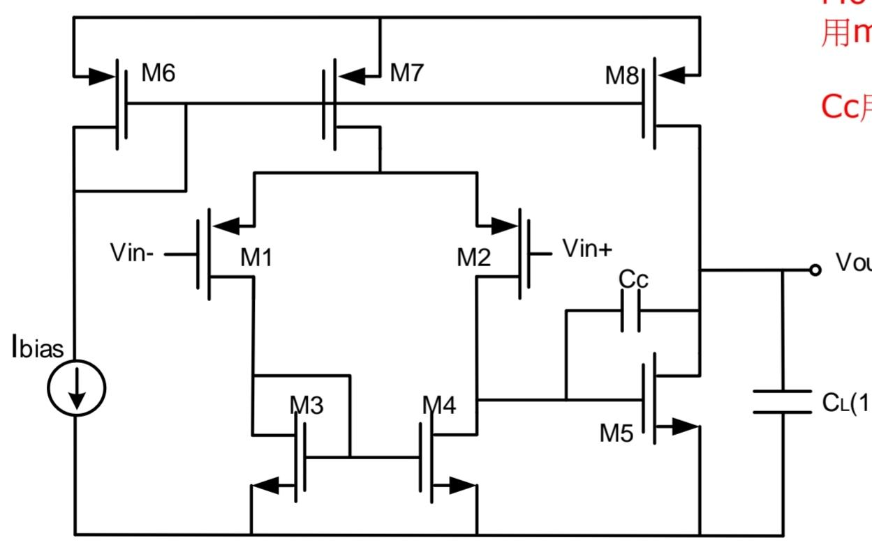
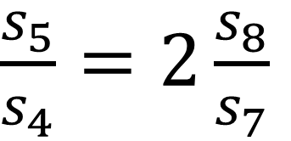
Balance conditions
If the input stage is perfectly balanced, then
=> ,
and

Slide 5
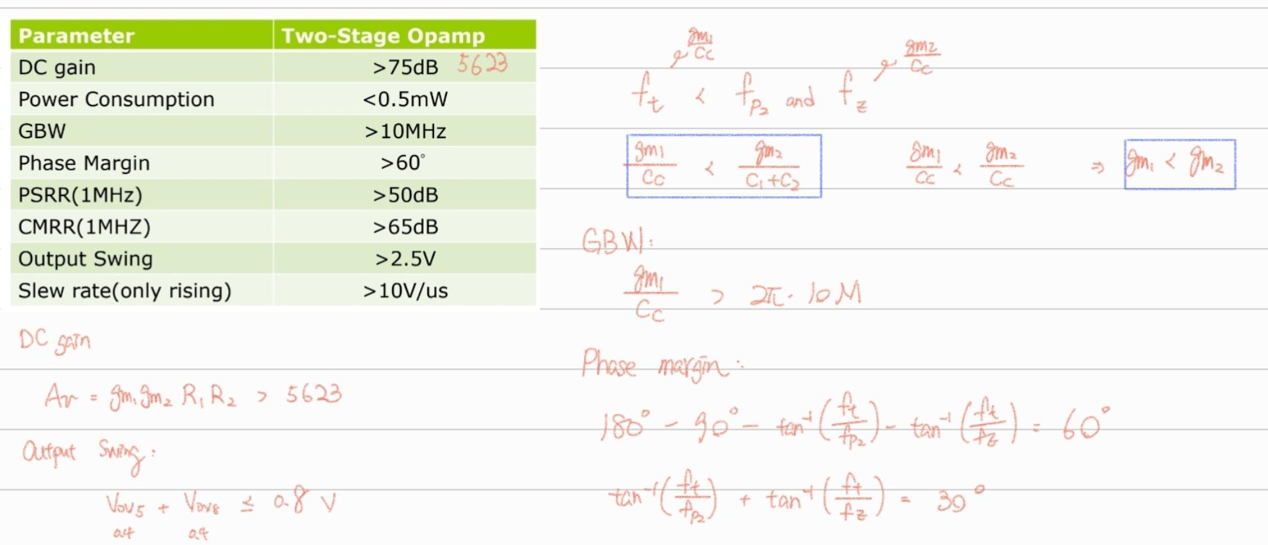
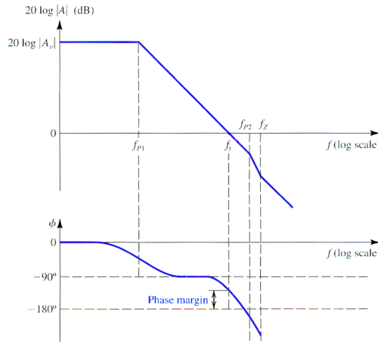
Some restrictions
The value of ωt is usually selected to be lower than the frequencies of nondominant poles and zeros.

Slide 6
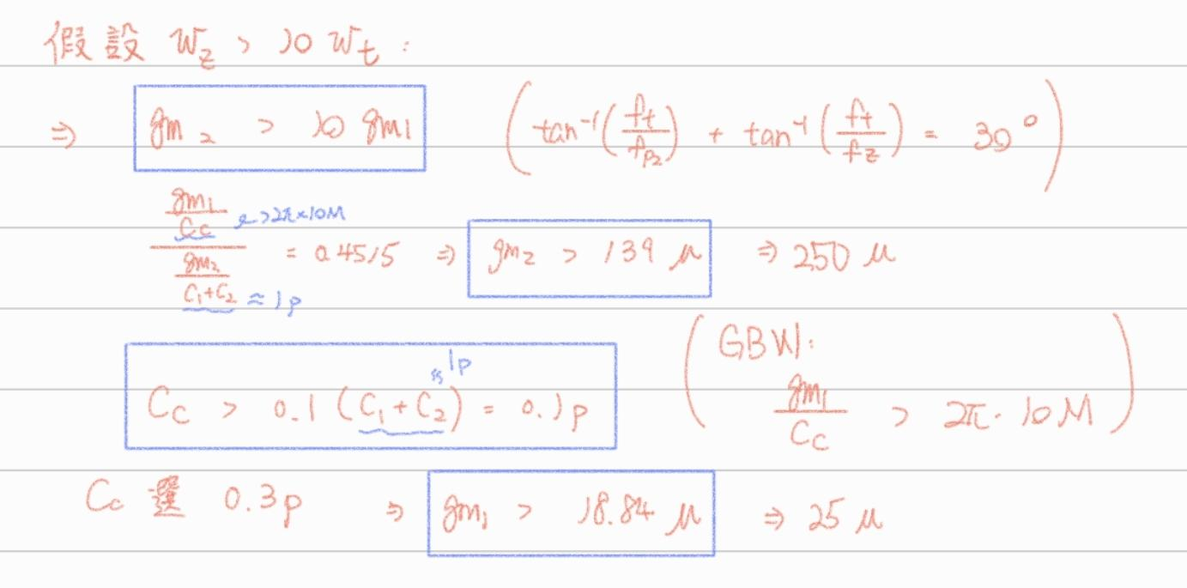
Some restrictions
choose gm2 = 250u
choose gm1 = 25u
choose Cc = 0.3p

Slide 7
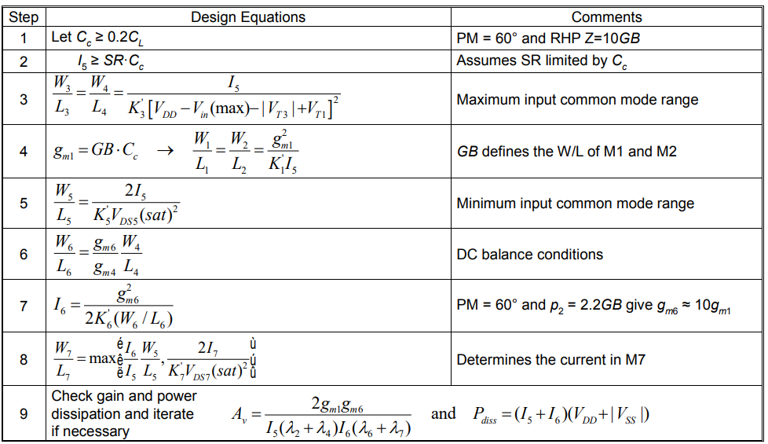
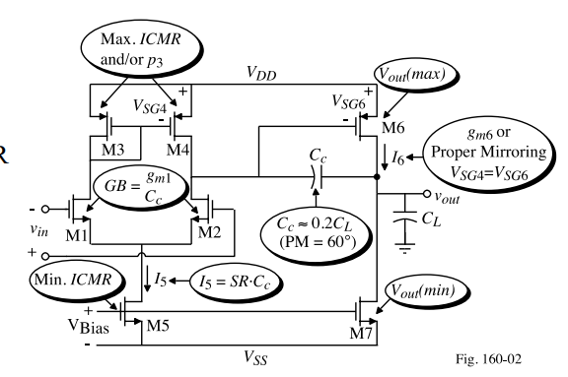
Op Amp Design Summary
Find a book that tell you how to build a two-stage op amp step by step.
https://aicdesign.org/wp-content/uploads/2018/08/lecture23-160311.pdf?fbclid=IwAR0GNiOoIuLp4Hz4dMZW4Pfnbgc-U_VKWpf1buwvI-D8Sp4smoU1tbyIBrE

Slide 8
Design procedure
Observe ratio between Mx
1.differential pair
2.determine M5
3.determine M7,M8
Calculation according to requirement
1.gm1,gm5 by phase margin
2.I7 by slew rate
3.assume Vov to get W/L
The calculated ratio is the worst case. Thus, stimulate and adjust on hspice

Slide 9
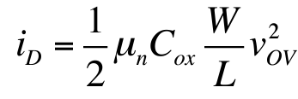

Basic concept to adjust the param
Let Vov ≅ 0.15~0.2V
Vov of M1,M2,M3,M4,M5 is determined by W/L
changing the pole may affect the gain and phase margin.
larger Cc cause a better phase margin

Slide 10
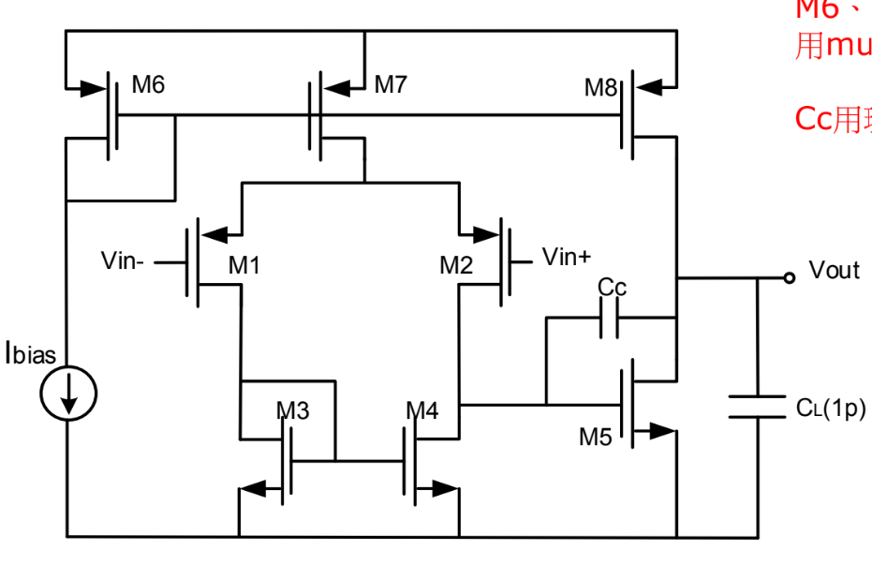
Basic concept to adjust the param
If the M5,M8 against the calculated ratio, M8 may be in Linear region.
M5 have larger ID, but W/L unchange, which means Vov increase. M8 may enter Linear.

Slide 11
Outline
Basic design rule
Structure
Stimulation results
Performance table
Problems

Slide 12
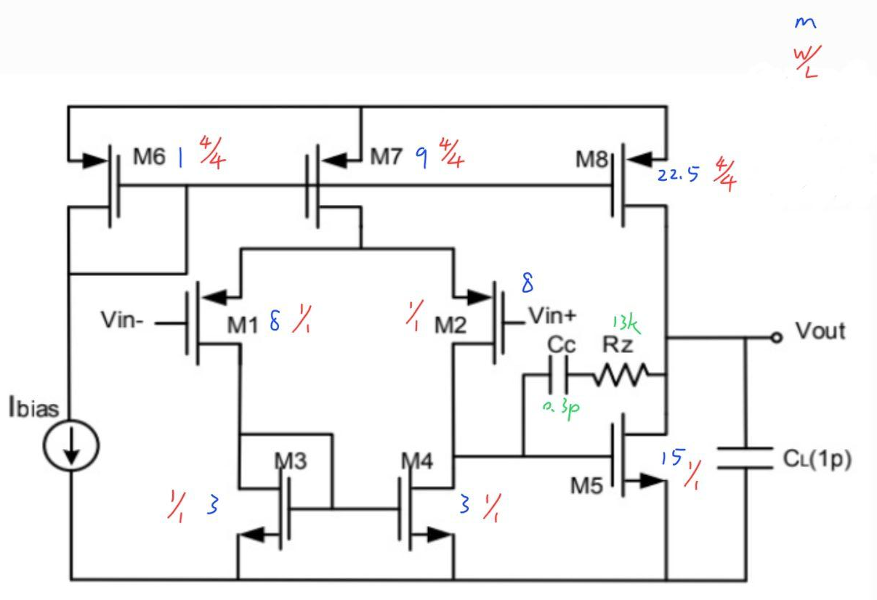
Optimal Sizes
 | W/L | M
M1 | 1u/1u | 8
M2 | 1u/1u | 8
M3 | 1u/1u | 3
M4 | 1u/1u | 3
M5 | 1u/1u | 15
M6 | 4u/4u | 1
M7 | 4u/4u | 9
M8 | 4u/4u | 22.5

Slide 13
Outline
Basic design rule
Structure
Stimulation results
Performance table
Problems

Slide 14
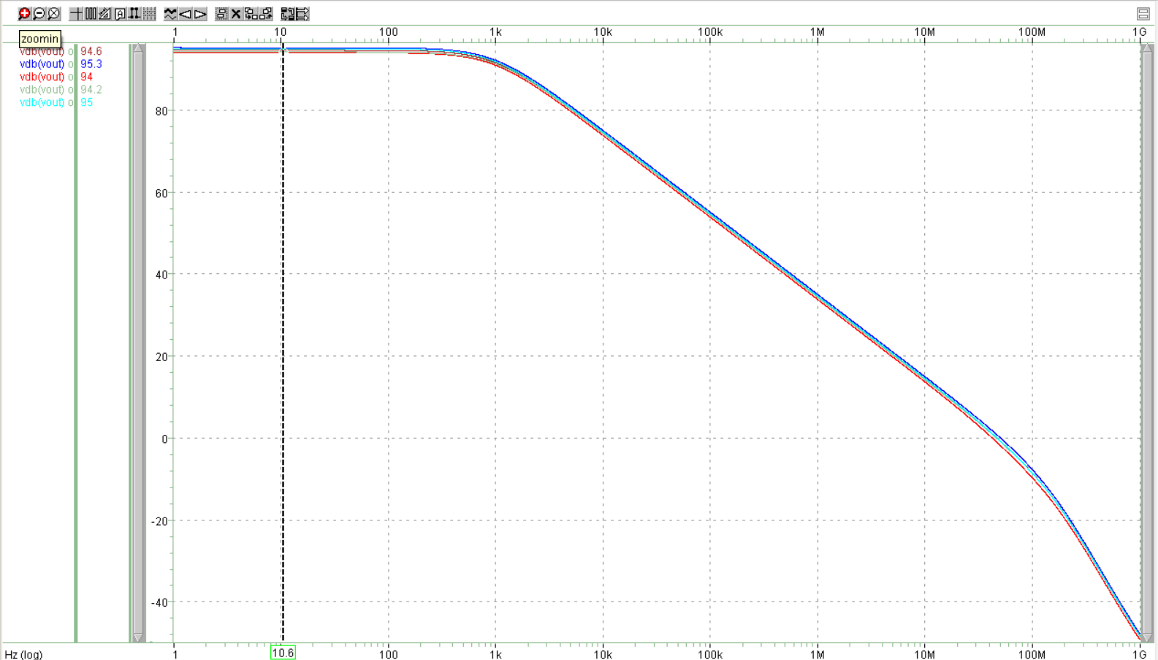
DC Gain
tt:90.6db
ff:95.3db
ss:94db
fs:94.2db
sf:95db

Slide 15
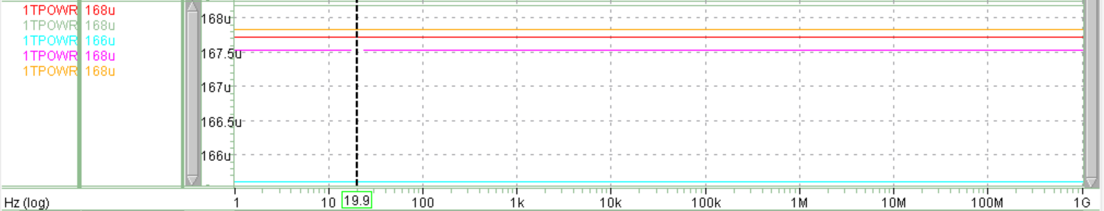
Power consumption
Power consumption≃0.167mW

Slide 16
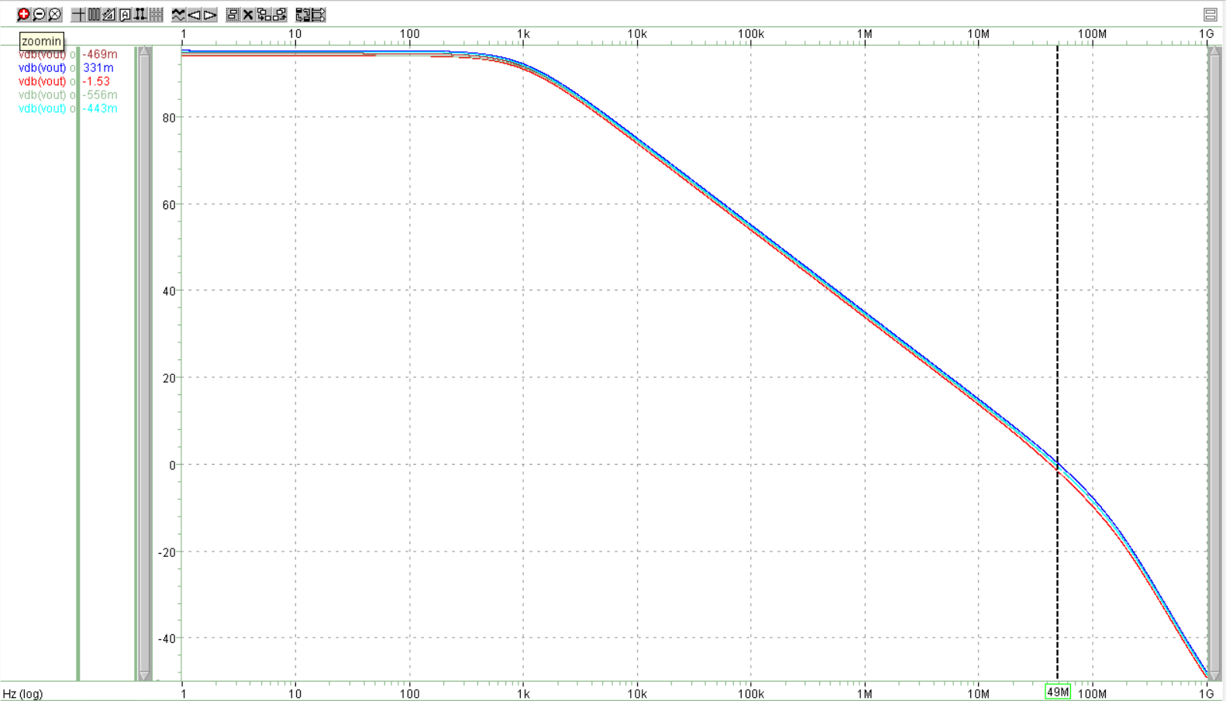
GBW
GBW≃49MHz

Slide 17
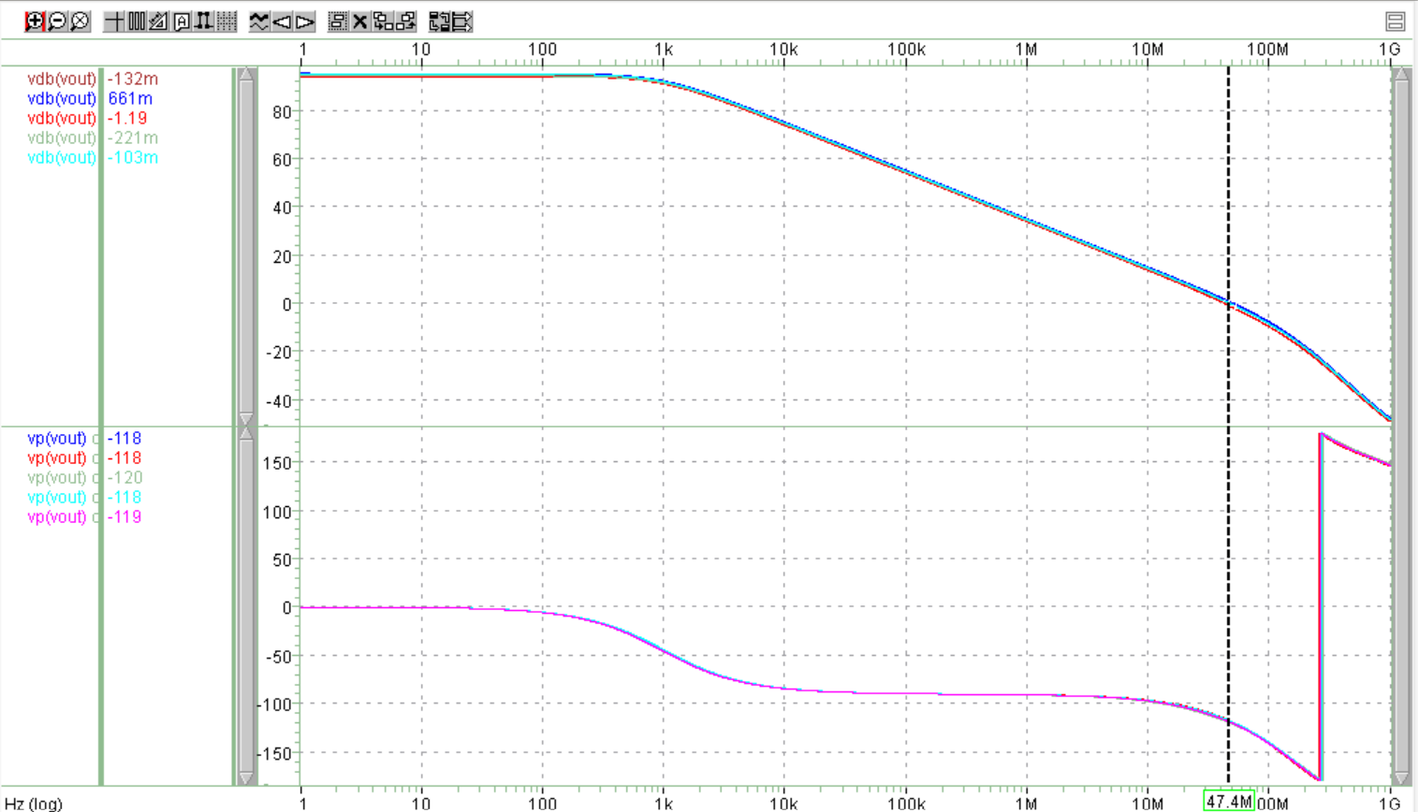
Phase margin
phase margin≃61

Slide 18
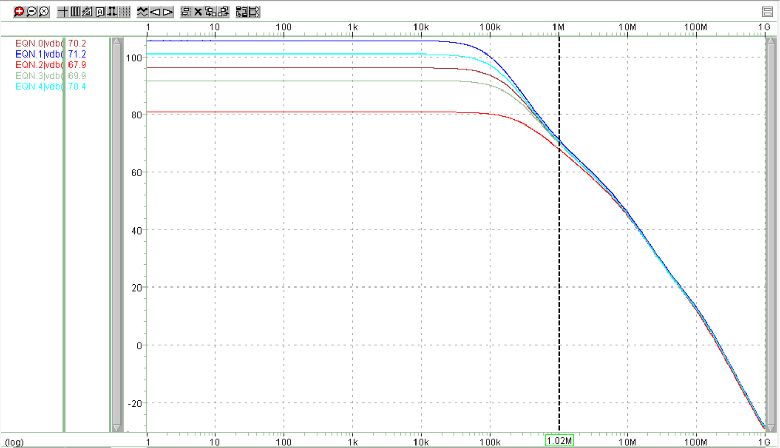
PSRR
tt:70.2db
ff:71.2db
ss:67.9db
fs:69.9db
sf:70.4db

Slide 19
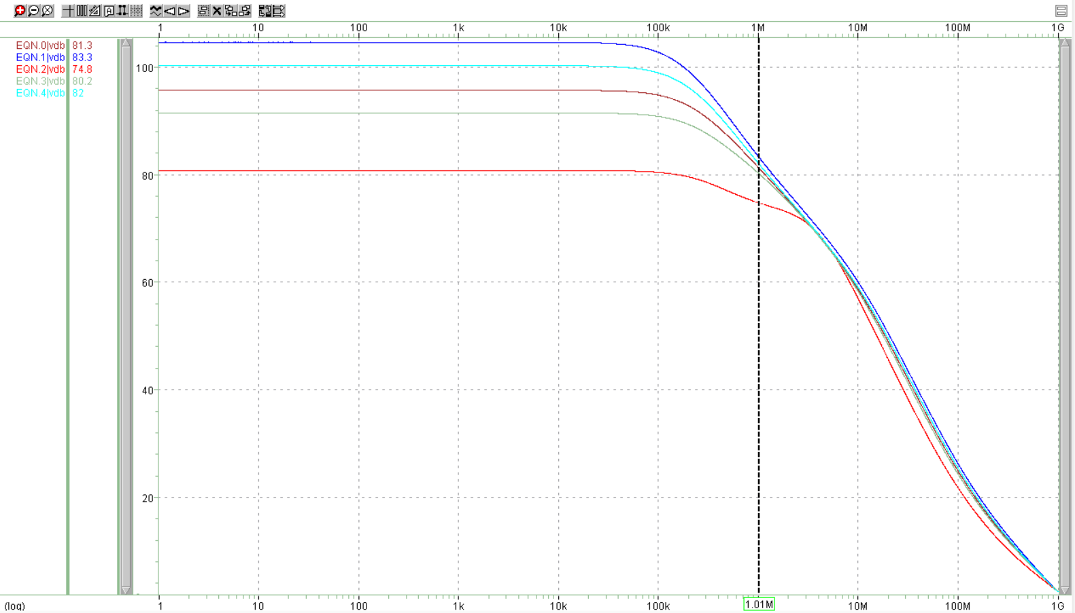
CMRR
tt:81.3db
ff:83.3db
ss:74.8db
fs:80.2db
sf:82db

Slide 20
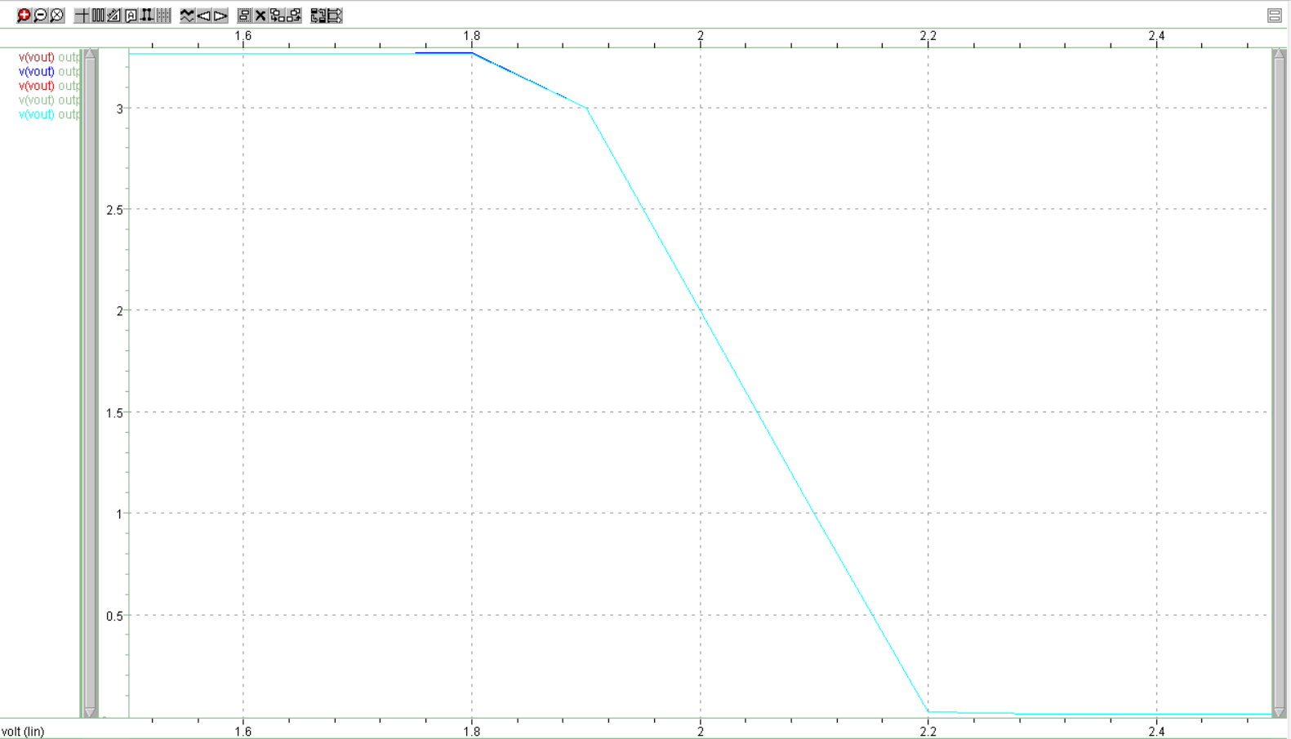
Output swing
tt:2.9V
ff:2.9V
ss:2.9V
fs:2.9V
sf:2.9V

Slide 21
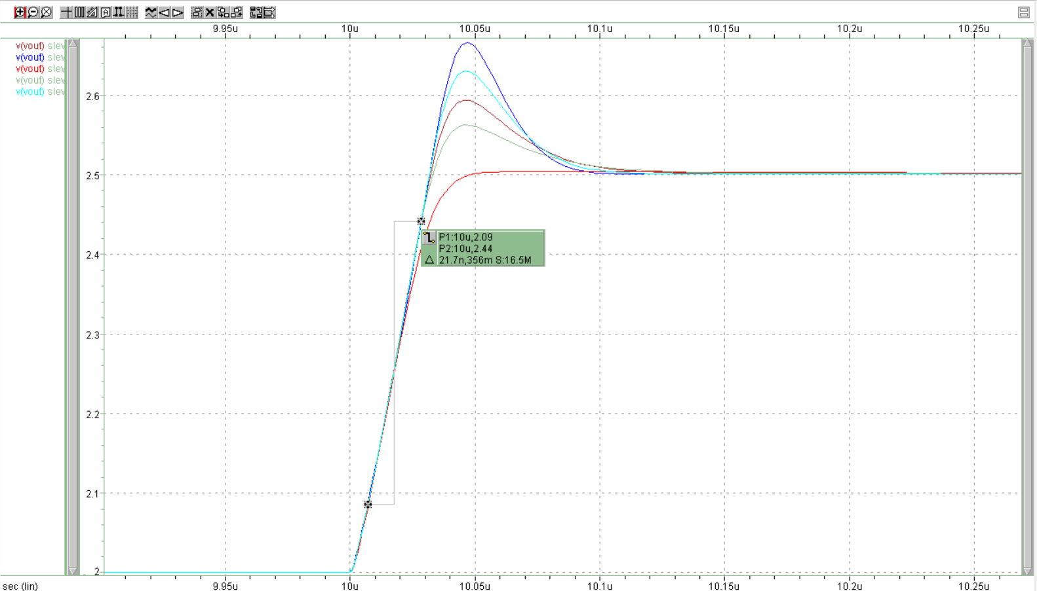
Slew rate
Slew rate≃16.5MV/1s
=16.5V/us

Slide 22
Outline
Basic design rule
Structure
Stimulation results
Performance table
Problems

Slide 23
Performance table
 | TT | FF | SS | FS | SF
DC gain | 90.6dB | 95.3dB | 94dB | 94.2dB | 95dB
Power consumption | 0.167mW | 0.167mW | 0.167mW | 0.167mW | 0.167mW
GBW | 49MHz | 49MHz | 49MHz | 49MHz | 49MHz
Phase margin | 61 | 61 | 61 | 61 | 61
PSRR(1MHz) | 70.2dB | 71.2dB | 67.9dB | 69.9dB | 70.4dB
CMRR(1MHz) | 81.3dB | 83.3dB | 74.8dB | 80.2dB | 82dB
Output swing | 2.9V | 2.9V | 2.9V | 2.9V | 2.9V
Slew rate(only rising) | 16.5V/us | 16.5V/us | 16.5V/us | 16.5V/us | 16.5V/us

Slide 24
Outline
Basic design rule
Structure
Stimulation results
Performance table
Problems

Slide 25
Problems
Some trade-off:
High gain → low bandwidth , large bandwidth → low gain
Larger size will be more robust but it won’t be compact
Large current cause a larger gain, however, some MOS will enter Linear.
lower gain(larger dominant pole) → better phase margin , higher gain(smaller dominant pole) → worse phase margin
Some specs are hard to measure, which took us lots of time to find out how to run the Hspice.
CMRR, PSRR - We need to split two file, and use the tools in nWave to calculate it.
We can get right waveform or right data by following the textbook, however, we don’t really understand the meaning of the measurement(output swing and slew rate).
We can hardly tell the differences between measuring in a feedback manner and not measuring in a feedback manner.

